Slide 1
Tradespace Exploration (TSE) Commercial Ship Case Study
Mike Curry
05 June 2018
Draper Proprietary

Slide 2
Overview of Tradespace Exploration (TSE)
Draper’s TSE capability enables the analysis of decision-making problems that have multiple objectives across all stages of the system lifecycle
What are underlying tradeoffs?
What do the best designs have in common?
What variables is the design sensitive to?
How does uncertainty affect design risk?
TSE provides a quantitative approach for decision-making with traceable rationale that can be more easily communicated
100
Cost & Configuration
Commitments
75
Knowledge
Cost Incurred
50
25
Management
Leverage
Concept
Development
Detailed
Design
Integration & Test,
Production
Use
Adapted from Blanchard & Fabrycky, 1998
Challenge: How does TSE enable the identification of good designs for a highly complex, multidimensional system such as a multi-mission commercial ship given uncertainty about the future?
Notes:
Shifts development of knowledge and key insight to when changes are easiest and least expensive

Slide 3
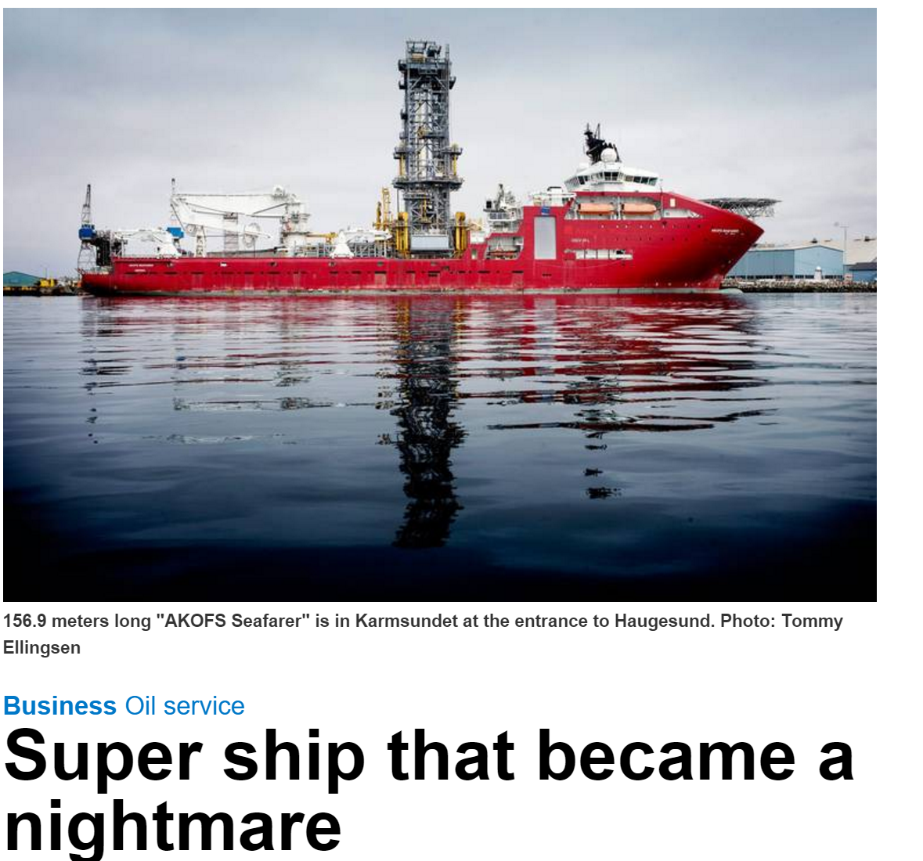
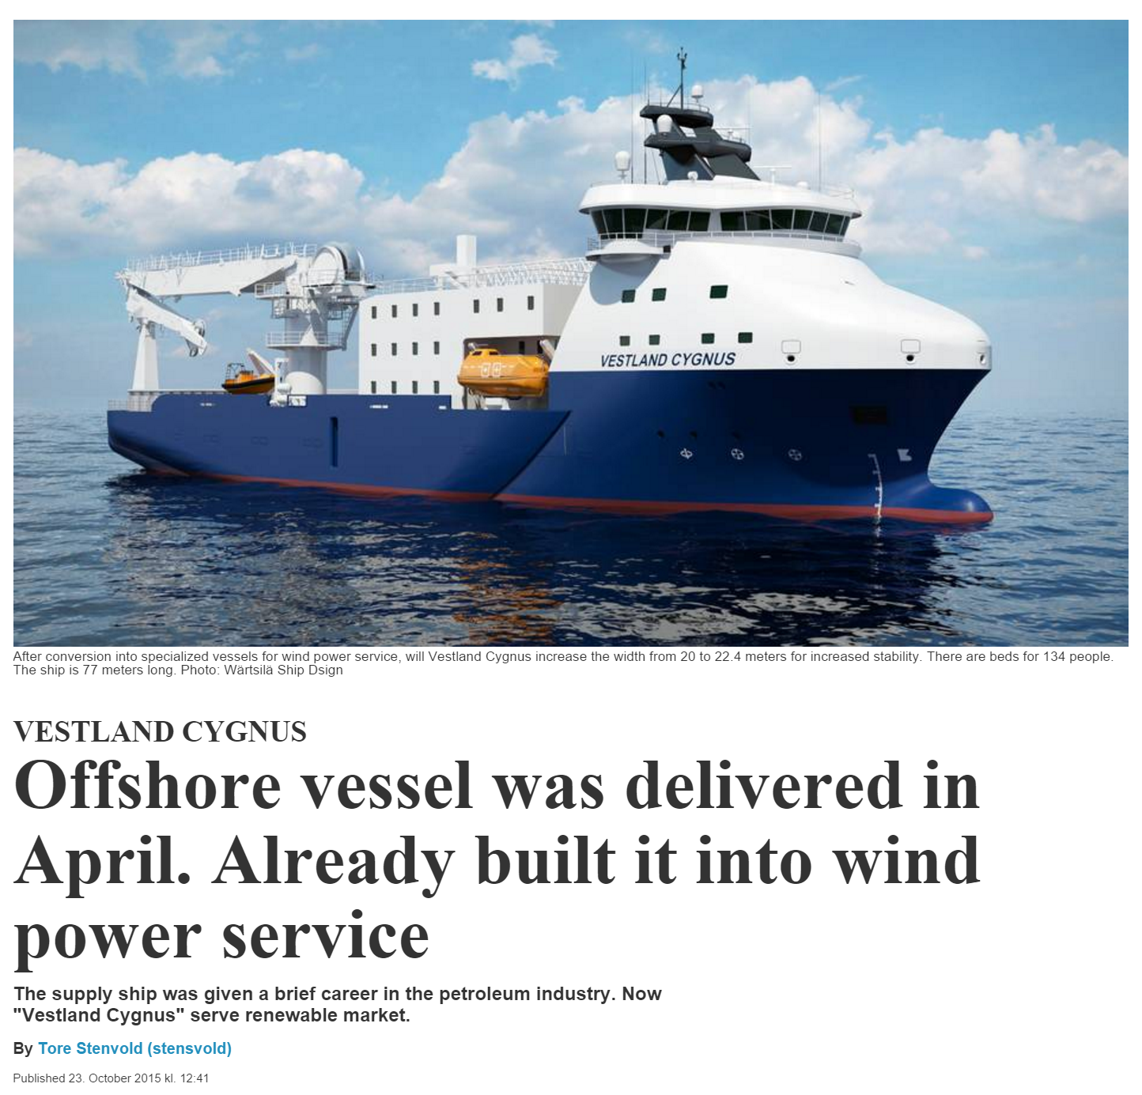
Commercial Offshore Ships
Case:
Offered in the spot market, after one year without any contracts.
Bad
Newbuild costs (2010):
Estimated $115M
Final 500M!
At order: Multi-purpose
Now: “Multi-useless”
AKOFS Seafarer
Case:
Originally delivered as an offshore supply vessel in 2015, but was immediately after delivery converted to a wind power service vessel.
Good
Original $37M
Retrofit $15M
Immediately repurposed for new mission
Vestland Cygnus
Notes:
The commercial offshore ship case study was developed in collaboration with MIT and SME’s from NTNU. The study focuses on the design of large ships that are primarily for applications like servicing offshore oil platforms, laying undersea cables, etc.
These ships have long development times and service lives which make them susceptible to future uncertainty
Volatility in prices in world oil markets has motivated ship-builders to reexamine the way they design these multi-function ships and shown here are two recent examples of when things did and did not go well.
The first example is the Seafarer which was built as a very large multi-mission ship, but by the time it entered service, oil prices had collapsed and it went without a contract for over a year.
Because it was big and multi-functional it was expensive to operate, and oil was now less profitable so they started refering to it as a ”multi-useless” ship
The second example here, the Cygnus, tells the opposite story. It was originally developed as an offshore supply vessel, but after delivery it was immediately converted to a wind power service vessel to remain useful and profitable.
The design elements that allowed one of these ships to be successful and the other to fail where not intentionally built into either design
The analysis to follow shows how we can bring in relevant considerations before the ships are built that increase the likelihood that they will be robust to future uncertainty.

Slide 4
Integrated Ship System Model
Decision and Context variables
Performance Attributes / Metrics
Hull Characteristics (Length, Beam, Width, etc)
Engine Characteristics (Power, Fuel)
Equipment Installed
Sea State
Characteristics
Stakeholder Needs
Hull Geometry
Mass
Stability Derivatives
Hull Mass
Available Deck
Area
Propulsion
Power
Mass Model
Equip.
Mass
Utility Function
Dead Weight / Useful Load
Hydro-Dynamics
Maximum
Speed
Eco
Model
Eco Friendliness Score
Cost
Model
Acquisition and Operations Cost
Combining each sub-analysis into an integrated system model enables us to conduct trades on the system-level variables of interest
MODM methods like utility theory allow us to evaluate all enumerated design on a common scale

Slide 5
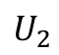

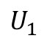
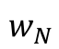
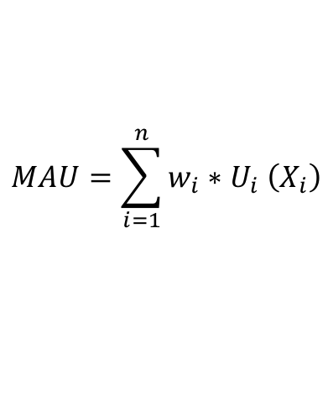
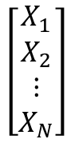
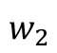
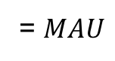
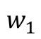
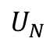

Multi Attribute Utility (MAU)
$$MAU=\sum_{i=1}^{n}{w_{i}{∗U}_{i}\left(X_{i}\right)}$$
Performance
Attributes
Stakeholder
SAU Functions
Weightings
Multi Attribute
Utility
$$U_{1}$$
$$∗$$
$$w_{1}$$
$$\left[\begin{matrix}X_{1} \\ X_{2} \\ ⋮ \\ X_{N}\end{matrix}\right]$$
Σ
$$U_{2}$$
$$∗$$
$$w_{2}$$
= $MAU$
…
$$U_{N}$$
$$∗$$
$$w_{N}$$
MAU allows us to evaluate all enumerated design on a common scale

Slide 6
Tradespace and Pareto Optimality
Running the integrated model for multiple permutations and levels of the design variables results in a large set of candidate alternatives (e.g. tradespace)
Occasionally only a subset of the possibilities within the decision space are important to consider for tradeoffs
This is the subset of all non-dominated points of the decision space
The solutions within this subset are dubbed Pareto Optimal solutions, and the entire subset is known as the Pareto frontier
If the requirements are adequately characterized, the designer wishes only to consider Pareto Optimal solutions
System alternatives can be examined in this way to identify the alternatives that balance the competing metrics that we are trading
Notes:
The appeal of this type of chart is that it boils down a lot of the information about the performance and costs of the system into a simplified graph where an analyst or decision-maker can now more easily identify Pareto efficient designs that are either optimal or near optimal,
but a lot of information has been abstracted away about the underlying design and performance variables.

Slide 7
Overview of Commercial Ship Case
Design Variable | Levels
Length [m] | [120, 150, 180]
Beam [m] | [20, 25, 30]
Depth [m] | [8, 13]
Installed Power [MW] | [15, 25]
Accommodation [persons] | [50, 250, 400]
Main Crane [tons] | [0, 400, 800]
Light well intervention tower [tons] | [0, 300, 600]
Moonpool | [no, yes]
Fuel Type | [MGO, Dual Fuel]
Dynamic Positioning | [no, yes]
Remotely operated vehicle | [no, yes]
Pipe-laying capability | [no, yes]
DFC Level | [0,1,2,3]
Scenario: A ship owner wants to target current and future contracts from customers with varying missions and preferences
Goals: Ensure profitability by providing value to customers, regardless of changing mission requirements, for as long as possible
Decision-maker is attempting to satisfy sets of preferences corresponding to different contracts in fluctuating oil markets
41,204 Design Alternatives
Performance Attribute
Speed [knots]
Deck Area [m²]
Dead Weight [tons]
Eco-friendliness
Expense Attributes
Acquisition Cost [$M]
Operational Costs [$M/yr]
Notes:
The ship case study can be conceptualized by defining key design variable, modeling their mapping to system performance and expense attributes, then enumerating the design space.
Notes:
Offshore ships, in contrast to traditional deep-sea cargo ships, are designed to provide special operational services typically related to the offshore oil and gas industry. This group of ships comprises platform supply vessels (PSV), inspection maintenance and repair (IMR) and offshore construction vessels (OCV), to mention a few. A recent period of high oil prices and deep sea petroleum discoveries has spurred the development of offshore oil and gas fields. Thus, there has been a growing need for offshore services, including well maintenance and intervention services with light, riserless technologies. OCVs have taken an increasingly large part in the development of these, in particular for the marginal fields, due to their price competitiveness. Additionally, the Deepwater Horizon oil spill in 2010 in the Gulf of Mexico has changed some of the focus for the offshore shipowners towards being able to provide various deepwater emergency and rescue operations. This strong market period has characteristically driven the design of offshore ships towards multifunctional, gold-plated and expensive solutions [12]. However, the recent oil price collapse of 2014 has had a significant impact on the offshore markets, rendering many of these multifunctional ships less competitive against cheaper, specialized ships. The current situation in the offshore industry serves as a good example of the importance of focusing on value robustness and operational flexibility as key factors for success in a highly volatile maritime industry [13,14].
Offshore ships are usually built either for a specific long-term contract or on speculation. A long-term contract may last 5-10 years, and these ships are often specialized for the particular mission. Ships built on speculation tend to be more multifunctional, to be able to take on different contracts. If these ships do not get any lucrative long-term contracts, they are often offered in the spot market to take on various short-term contracts. If a ship does not get a contract, it is idle for short periods or laid up over longer periods.
For the offshore ship, the various key performance indicators are estimated based on simple relations from the design variables, including speed, deck area, dead weight, acquisition cost and operational costs. Designs that violate the technical requirements in an epoch are rendered infeasible.

Slide 8
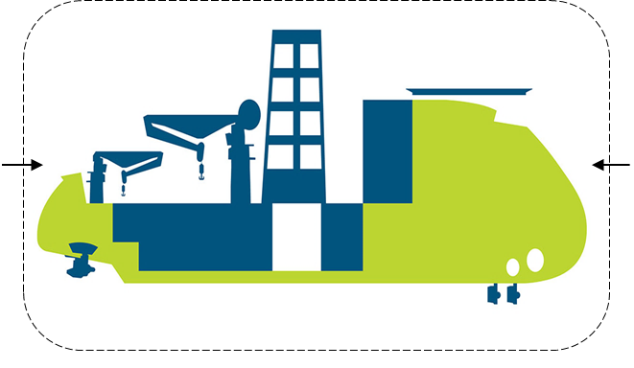
Epoch-space Characterization
12 Possible Missions
Subsea installation & Construction
Inspection, maintenance and repair
Light well intervention
Offshore accommodation
Offshore cable laying
Offshore pipe laying
Offshore platform supply
Emergency response
Offshore mining support
Offshore aquaculture support
Field decommission support
Offshore wind support
Each of the 96 epochs defined by:
(12) Mission types
(2) Contract rate and type [spot/term]
(4) Operational Areas
Potential evaluation space: design x epoch ≈ 40K x 100 ≈ 4M evals
Contract
- Rate [kUSD/day]
- Type [day rate/6 mos to 5 yrs]
Mission requirements
Light well int. [tonnes]
Subsea module [tonnes]
Accommodation [POB]
Remotely operated vehicle
Deck area [m²]
Operational area
Gulf of Mexico
North Sea
Brazil
West Africa
Area information
Sea state (Hs) [m]
Water depth [m]
Notes:
A similar story with data scale is seen when we look at the epoch space
The key exogenous uncertainties that impact ship operations and how much value they deliver to stakeholders are the mission, contract type and operational area
Enumerating the combinations of these 3 factors results in 96 possible epochs.
To consider the different missions, contract types and areas of operation required the enumeration of 96 epochs
This means the number of design-epoch pairs was around 4 million. Much larger then the 6,000 or so for the space tug case.

Slide 9
Live Demo Here

Slide 10
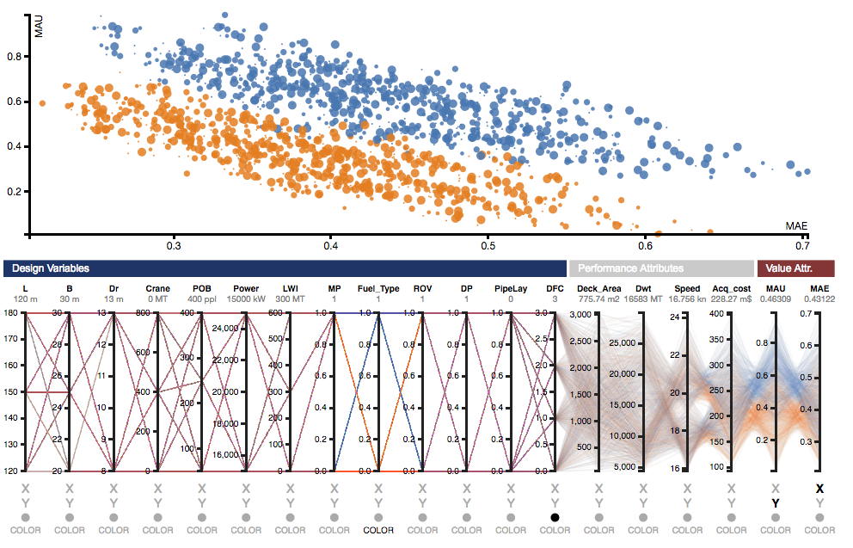
Single Epoch Analysis
Live Demo
Interactive scatterplot identical to previous case study
Some consideration made for scalability
Tradespace with color encoding mapped to fuel type
N= 41,204 designs
Epoch = i
(This is 1 of 96 epochs)

Slide 11
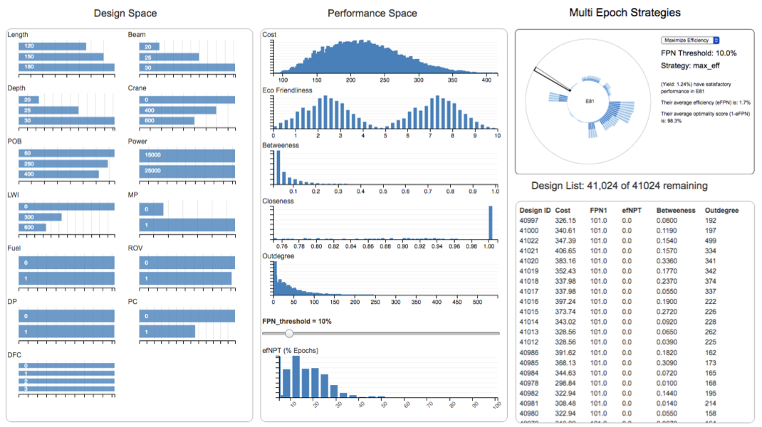
Multi Epoch Analysis
Live Demo
Multi epoch analysis looks at design behavior across all 96 epochs (e.g. scenarios)
Combination of online analytical processing (OLAP) and binned aggregation techniques used for more sophisticated interactive applications
Interactive Linked Bar/Row Charts
Details on demand reveal info on “problem epochs”
Aggregate performance across 4 million design-epoch pairs
Allows comparison changeability strategies
3 changeability strategies considered
Filtered subset of designs based on epoch performance
Few designs satisfy more than 50% of epochs for this optimality threshold and strategy

Slide 12
Multi Attribute Utility (MAU)
$$MAU=\sum_{i=1}^{n}{w_{i}{∗U}_{i}\left(X_{i}\right)}$$
Performance
Attributes
Stakeholder
SAU Functions
Weightings
Multi Attribute
Utility
$$U_{1}$$
$$∗$$
$$w_{1}$$
$$\left[\begin{matrix}X_{1} \\ X_{2} \\ ⋮ \\ X_{N}\end{matrix}\right]$$
Σ
$$U_{2}$$
$$∗$$
$$w_{2}$$
= $MAU$
…
$$U_{N}$$
$$∗$$
$$w_{N}$$
MAU allows us to evaluate all enumerated design on a common scale

Slide 13
Single Epoch Analysis
Interactive scatterplot identical to previous case study
Some consideration made for scalability
Tradespace with color encoding mapped to fuel type
N= 41,204 designs
Epoch = i
(This is 1 of 96 epochs)

Slide 14
Multi Epoch Analysis
Multi epoch analysis looks at design behavior across all 96 epochs (e.g. scenarios)
Combination of online analytical processing (OLAP) and binned aggregation techniques used for more sophisticated interactive applications
Interactive Linked Bar/Row Charts
Details on demand reveal info on “problem epochs”
Aggregate performance across 4 million design-epoch pairs
Allows comparison changeability strategies
3 changeability strategies considered
Filtered subset of designs based on epoch performance
Few designs satisfy more than 50% of epochs for this optimality threshold and strategy
Notes:
An offshore ship may be seen as a movable flexible platform that can carry equipment that enables the ship to take on contracts of various types. The size of the platform may also change through, for example, elongation, but at a higher cost and duration, compared to more traditional equipment retrofits on deck. Single and multi-era analyses using interactive visualizations as shown in Figure 6 can aid in the assessment of different classes of changeability for the offshore design case. For brevity, this analysis is not discussed in this paper, but the interested reader is referred to previous demonstrations in prior case studies using IEEA [4] for further details.

Slide 15
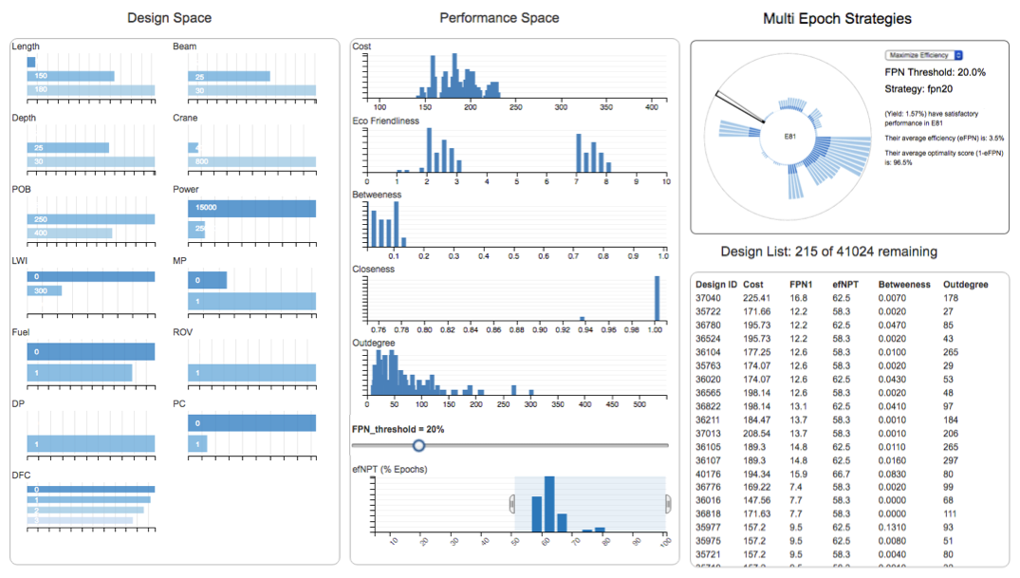
Multi Epoch Analysis
Multi epoch analysis looks at design behavior across all 96 epochs (e.g. scenarios)
Combination of online analytical processing (OLAP) and binned aggregation techniques used for more sophisticated interactive applications
Interactive Linked Bar/Row Charts
Satisfactory designs trend towards ones with larger deck area and stability
Details on demand reveal info on “problem epochs”
Allows comparison changeability strategies
Filtered subset of designs based on epoch performance
Relax optimality threshold
Filter for designs that satisfy most epochs
Notes:
An offshore ship may be seen as a movable flexible platform that can carry equipment that enables the ship to take on contracts of various types. The size of the platform may also change through, for example, elongation, but at a higher cost and duration, compared to more traditional equipment retrofits on deck. Single and multi-era analyses using interactive visualizations as shown in Figure 6 can aid in the assessment of different classes of changeability for the offshore design case. For brevity, this analysis is not discussed in this paper, but the interested reader is referred to previous demonstrations in prior case studies using IEEA [4] for further details.

Slide 16
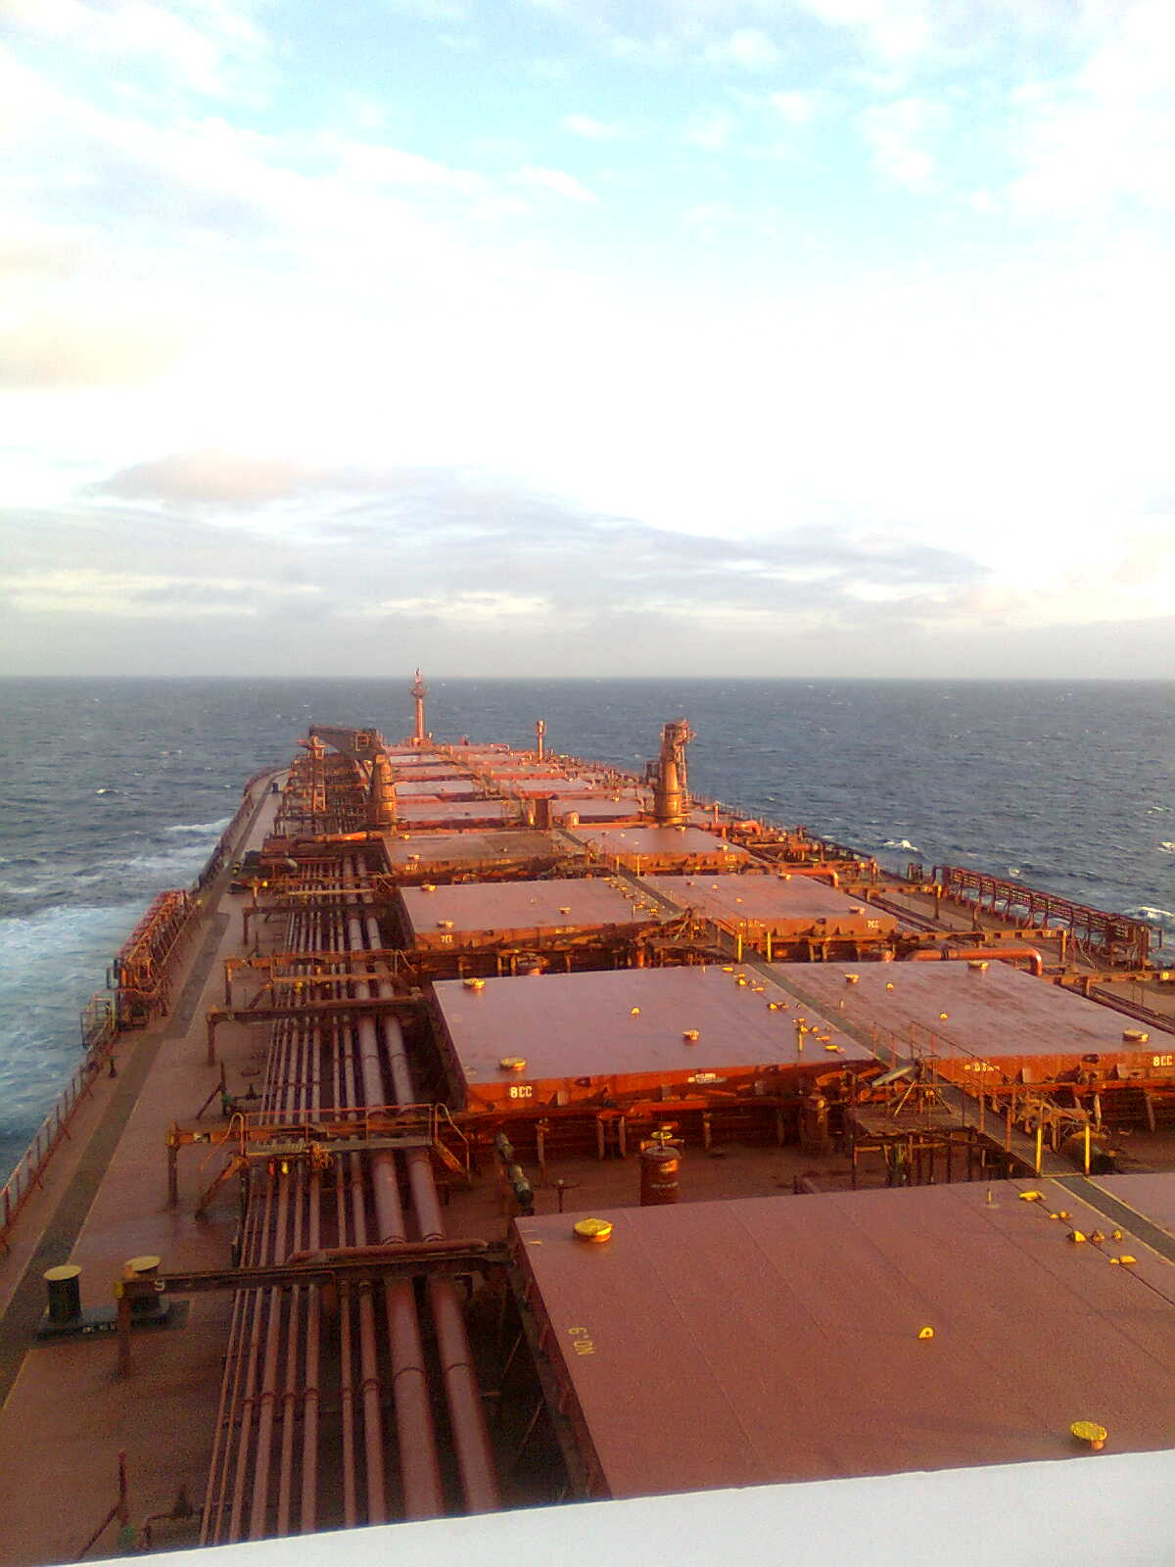
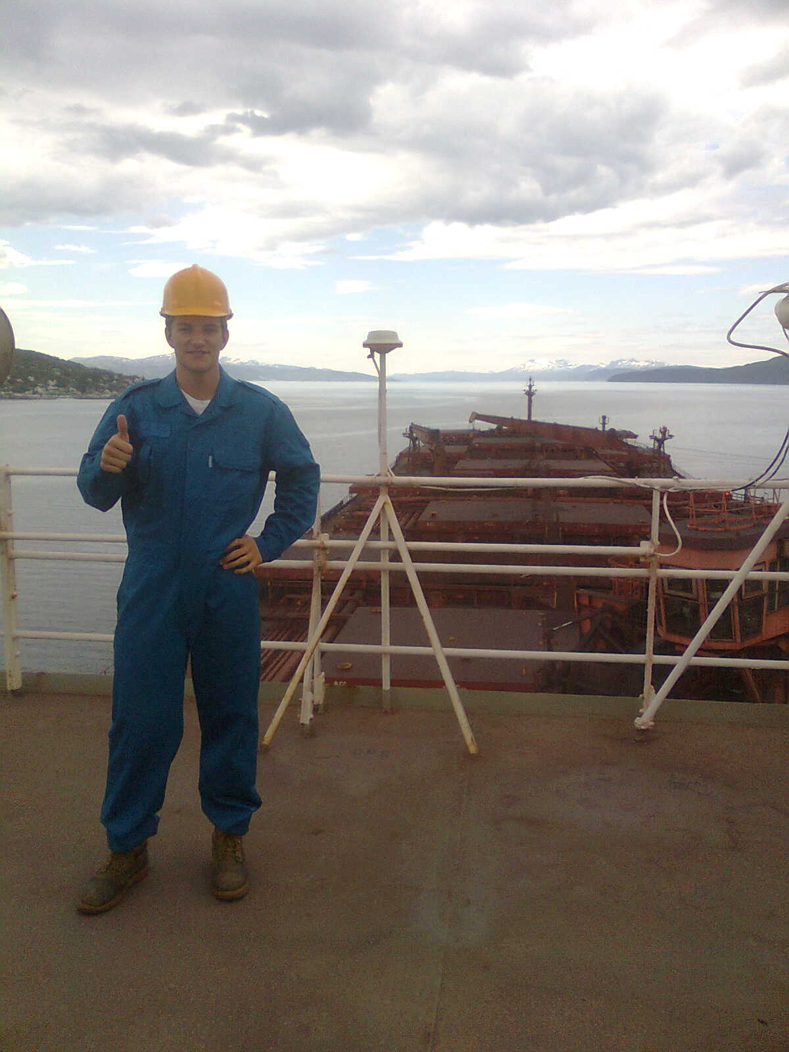
Example Versatility in Marine Systems
Combination Carriers, can carry wet or dry bulk
Capability to transport oil or iron ore
Embedded real option to operate differently to enable switching between markets
Higher CAPEX, with both cargo hatches and oil equipment.
Higher income opportunities.
Value of versatility emerges at tradeoff of cost (e.g. CAPEX) vs. potential contract wins
Carl Rehn, Front Striver, 2010.
Notes:
Another changeability example showing flexibility option which allows deck space to be used for multiple markets.
Higher CAPEX
Value?

Slide 17
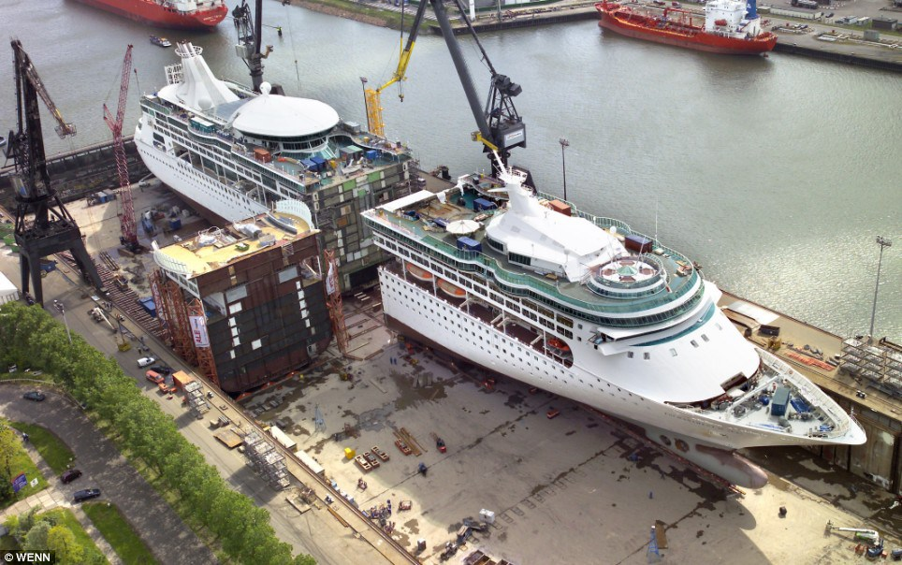
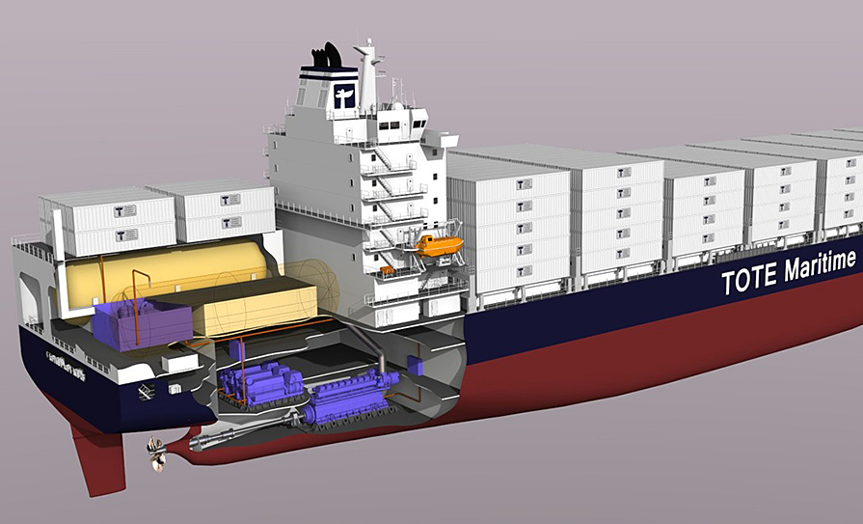
Example Changeability in Marine Systems
Two example change options
Expand capacity: jumboisation
Switch fuel: HFO - LNG
Source: http://www.cruisearabiaonline.com/Industry-Focus/2014/09/22/Why-do-cruise-lines-lengthen-existing-cruise-ships-and-how-did-this-practice-come-about
Source: http://hhpinsight.com/marine/2013/06/lng-container-ship-ferry-take-honors/
Notes:
Implementation of changeability in the offshore ship case enables the system to mitigate risk and take advantage of opportunities in a future operational context. This is enabled by selecting designs the meet the objectives of the primary contract, but also providing the flexibility to be able to change the design later based on the next state of operation, which is uncertain at the initial design stage.
The previous slide talked mainly about identifying robust designs
This slide shows 2 ways changeability can be used sustain value
(Expand capacity) Modifying the hull using jumboisation
(Change inputs to production) Switch the fuel type used

